Slide 1
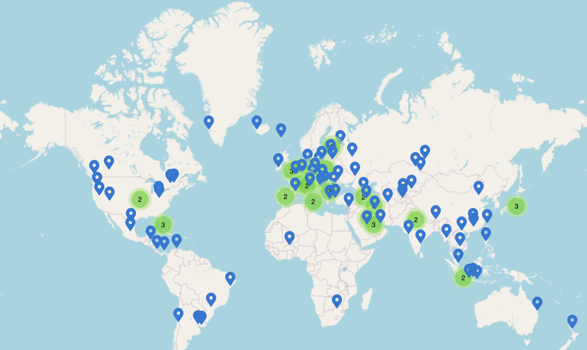
DNS
Lecture 14 (Applications 1)
CS 168, Spring 2026 @ UC Berkeley
Slides credit: Sylvia Ratnasamy, Rob Shakir, Peyrin Kao, Nicholas Ngai, Nicholas Weaver
Notes:
Slides template credit: Josh Hug, Lisa Yan

Slide 2
What is DNS For?
DNS
What is DNS For?
Design
Implementation
Scaling
Other Uses
Lecture 14, CS 168, Spring 2026

Slide 3
Application Layer
Lots of applications are built on the Internet infrastructure we've seen.
We'll focus on some common ones:
DNS (today).
HTTP (next time).
7
Application
(DNS, HTTP)
4
Transport
(TCP, UDP)
3
Network
(IP)
2
Data Link
(Ethernet)
1
Physical
(Optical fiber, copper)

Slide 4
Domain Names
Recall: Computers are addressed by IP address.
Example: 74.125.25.99.
Useful for machines: Helps making routing scalable.
Not useful for humans: Numbers not meaningful to humans. Hard to remember.
Alternative addressing system: Human-readable domain names.
Example: www.google.com.
Not useful for machines: Contains no relevant routing information.
Useful for humans: Meaningful words and phrases, easy to remember.

Slide 5
DNS: Definition
DNS (Domain Name System): An Internet protocol for translating human-readable domain names to IP addresses.
Usage:
You want to send a packet to a certain domain (e.g. you type a domain into your browser).
Your computer performs a DNS lookup to translate the domain name to an IP address.
Your computer sends the packet to the corresponding IP address.
www.google.com
DNS
74.125.25.99

Slide 6
Brief History of DNS
On the Internet and ARPANET (its predecessor), three main applications.
Remote terminal (telnet 34.8.12.0):
Connect to someone else's machine remotely. SSH is a modern successor.
File transfer (ftp 74.1.254.1):
Copy files across the network.
Email (mail alice@88.1.24.0):
Send a message to another user.
Remembering the remote host address is difficult for humans.

Slide 7
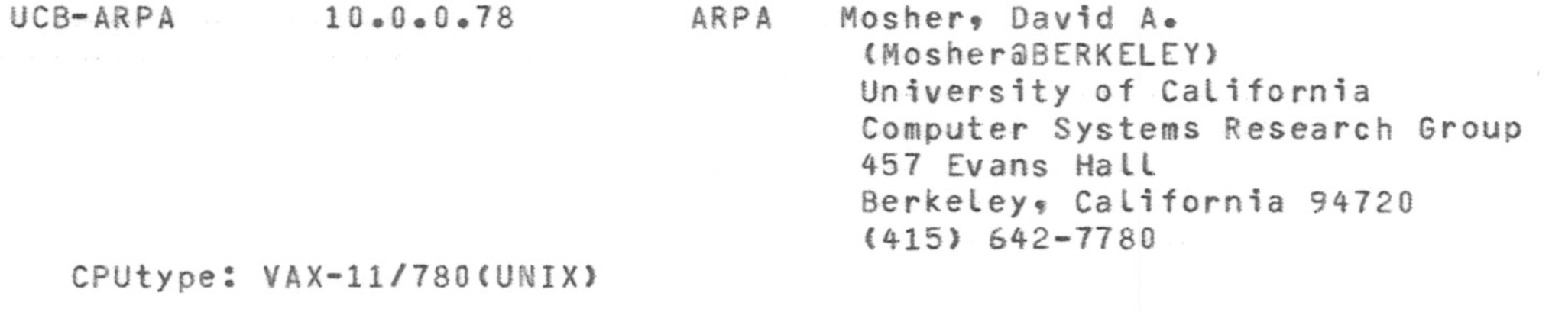
Brief History of DNS
Original design: Computers had a hosts.txt file that mapped names to IP addresses.
Example: ucb-arpa maps to 10.0.0.78.
Using IP address: mail mosher@10.0.0.78.
Using hostname: mail mosher@ucb-arpa.
Originally maintained by Elizabeth Jocelyn "Jake" Feinler.
The file was photocopied and exchanged between users.

Slide 8
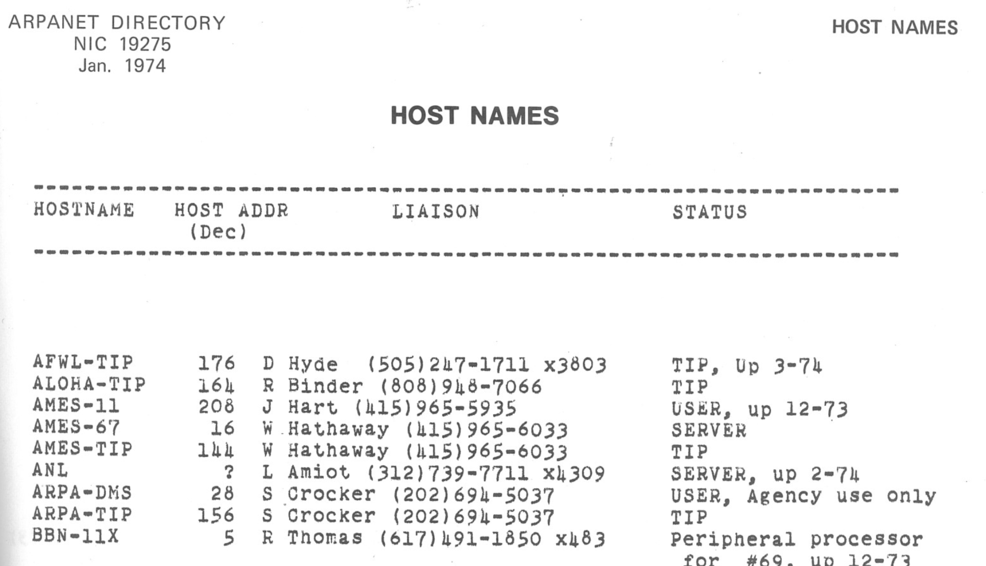
Brief History of DNS
Originally, hosts.txt was human-readable.
"I remembered that back then we simply xeroxed the hosts.txt file and put it into the Arpanet Directory, so I copied that." –Elizabeth Feiner
Notes:
https://elists.isoc.org/pipermail/internet-history/2008-January/000702.html

Slide 9
Brief History of DNS
Problems with hosts.txt:
Everyone needs to use the same file.
  If you type mail mosher@ucb-arpa on different computers, you should be emailing the same person.
Users might have an outdated file.
It seems about time to put an end to the absurd situation where each site on the network must maintain a different, generally out-of-date, host list.
–RFC 606 (1973)

Slide 10
Brief History of DNS
First step: Make the file machine-readable.
Can use FTP to transfer the hosts.txt file between computers.
Scaling is still an issue as the Internet grew.
Could end up with a partial file if the download breaks halfway through.
NET : 44.0.0.0 : AMPRNET :
NET : 45.0.0.0 : C3-PR :
NET : 46.0.0.0 : UCB-ETHER :
NET : 47.0.0.0 : SAC-PR-TEMP :
HOST : 46.0.0.4 : UCBARPA : VAX-11/780 : UNIX : TCP/TELNET,TCP/FTP,UDP :
HOST : 46.0.0.5 : UCBCAD : VAX-11/780 : UNIX : TCP/TELNET,TCP/FTP,UDP :
HOST : 46.0.0.6 : UCBERNIE : VAX-11/780 : UNIX : TCP/TELNET,TCP/FTP,UDP :
HOST : 46.0.0.7 : UCBMONET : VAX-11/750 : UNIX : TCP/TELNET,TCP/FTP,UDP :
HOST : 46.0.0.9 : UCBESVAX : VAX-11/780 : UNIX : TCP/TELNET,TCP/FTP,UDP :
HOST : 46.0.0.10 : UCBVAX : VAX-11/780 : UNIX : TCP/TELNET,TCP/FTP,UDP :
Check out RFC608 and this 1983 hosts file.

Slide 11
Brief History of DNS
DNS was first proposed in RFC882 (1983).
We use this system (with some modifications – but not many) today.
There's a huge amount of DNS history here at UC Berkeley!
First DNS server written for Unix was BIND.
berkeley.edu is the oldest .edu domain!
The Berkeley Internet Name Domain Server |  | Link
Douglas B. Terry, Mark Painter, David W. Riggle, Songnian Zhou (UC Berkeley) |  | 1984

Slide 12
Goals of DNS
DNS must be scalable.
Many hosts/names. Many lookups. Many updates.
DNS must be highly available.
No single point of failure.
DNS must be lightweight and fast.
Connections often start with a name lookup (e.g. user typing domain in browser).
If DNS is slow, every connection is slow.
www.google.com
DNS
74.125.25.99

Slide 13
DNS Design
DNS
What is DNS For?
Design
Implementation
Scaling
Other Uses
Lecture 14, CS 168, Spring 2026

Slide 14
DNS Name Servers
Name server: A server on the Internet responsible for answering DNS requests.
Name servers have domain names and IP addresses too.
Example: There's a name server with name a.edu-servers.net and IP 192.5.6.30.
DNS is a client-server, request-response protocol.
To perform a DNS lookup, you (the client) send a DNS query:
"What is the IP address of www.google.com?"
The name server sends a DNS response with the answer:
"The IP address of www.google.com is 74.125.25.99."
Issues:
One name server can't handle every DNS request from the entire Internet.
If there are many name servers, how do you know which one to contact?

Slide 15
DNS Name Server Hierarchy
Idea #1: If one name server doesn't know the answer to your query, the name server can direct you to another name server.
Analogy: If I don't know the answer to your question, I will direct you to a friend who can help.
Idea #2: Arrange the name servers in a tree hierarchy.
Intuition: Name servers will direct you down the tree until you receive the answer to your query.
. (root)
.edu
.org
.com
berkeley.edu
mit.edu
cs161.org
piazza.com
google.com

Slide 16
DNS Name Server Hierarchy
Each box is a name server. The label represents which queries the name server is responsible for answering.
This name server is responsible for .edu queries like eecs.berkeley.edu, but not a query like mail.google.com.
. (root)
.edu
.org
.com
berkeley.edu
mit.edu
cs161.org
piazza.com
google.com

Slide 17
Steps of a DNS Lookup
Let's walk through a DNS query for the IP address of eecs.berkeley.edu.
. (root)
You
.edu
.org
berkeley.edu
mit.edu
cs161.org

Slide 18
Steps of a DNS Lookup
First, you check your cache to see if you already know the answer to your query.
Hmm, I don't remember previously seeing the IP address of eecs.berkeley.edu.
. (root)
You
.edu
.org
berkeley.edu
mit.edu
cs161.org

Slide 19
Steps of a DNS Lookup
DNS queries always start with a request to the root name server, which is responsible for all requests.
"What is the IP address of eecs.berkeley.edu?"
. (root)
You
1
.edu
.org
berkeley.edu
mit.edu
cs161.org

Slide 20
Steps of a DNS Lookup
The root name server responds by directing you to the correct child name server (in this case, the .edu name server).
. (root)
You
1
2
"I don't know, but I have delegated authority to the .edu name server."
.edu
.org
berkeley.edu
mit.edu
cs161.org

Slide 21
Steps of a DNS Lookup
Next, you ask the same question, but now to the .edu name server.
. (root)
You
1
2
.edu
.org
3
"What is the IP address of eecs.berkeley.edu?"
berkeley.edu
mit.edu
cs161.org

Slide 22
Steps of a DNS Lookup
The .edu name server redirects you to the berkeley.edu name server.
. (root)
You
1
2
.edu
.org
3
4
"I don't know. But I have delegated authority to the berkeley.edu name server."
berkeley.edu
mit.edu
cs161.org

Slide 23
Steps of a DNS Lookup
Next, you ask the same question, but now to the berkeley.edu name server.
. (root)
You
1
2
.edu
.org
3
4
5
berkeley.edu
mit.edu
cs161.org
"What is the IP address of eecs.berkeley.edu?"

Slide 24
Steps of a DNS Lookup
The berkeley.edu name server responds with the answer.
You can cache the answer to avoid having to ask again later.
. (root)
You
1
2
.edu
.org
3
4
5
6
berkeley.edu
mit.edu
cs161.org
"The IP address of eecs.berkeley.edu is 23.185.0.1."
Store this in your cache for the next 24 hours so you don't bother me again with the same request.

Slide 25
Stub Resolvers and Recursive Resolvers
In practice, your computer usually tells another resolver to perform the query for you.
Stub resolver: The resolver on your computer.
Only contacts the recursive resolver and receives the answer.
Recursive resolver: The resolver that makes the actual DNS queries.

Slide 26
Steps of a DNS Lookup (With Recursive Resolver)
Stub Resolver
1
The stub resolver sends the query to the recursive resolver.
. (root)
Recursive Resolver
.edu
.org
berkeley.edu
mit.edu
cs161.org

Slide 27
Steps of a DNS Lookup (With Recursive Resolver)
The recursive resolver contacts all the name servers to answer the query, as we saw earlier.
Stub Resolver
1
. (root)
2
Recursive Resolver
3
4
.edu
.org
5
6
berkeley.edu
mit.edu
cs161.org
7

Slide 28
Steps of a DNS Lookup (With Recursive Resolver)
Stub Resolver
The recursive resolver returns the final answer to the stub resolver.
1
8
. (root)
2
Recursive Resolver
3
4
.edu
.org
5
6
berkeley.edu
mit.edu
cs161.org
7

Slide 29
Recursive Resolvers
How do we know where the recursive resolver is?
When you first join the network, somebody can tell you a resolver address.
You can use a well-known resolver with a memorable IP address.
  1.1.1.1 (operated by Cloudflare).
  8.8.8.8 (operated by Google).
Why are recursive resolvers useful?
The recursive resolver can build a larger cache from multiple users' requests.
  If you query for www.google.com for the first time, the recursive resolver might have the answer cached from somebody else's query.
Reduces load on name servers.
  Recursive resolver asks the name server for www.google.com once, and can serve the answer to many users.
Recursive resolvers usually run by ISPs or application providers (Google, Cloudflare).

Slide 30
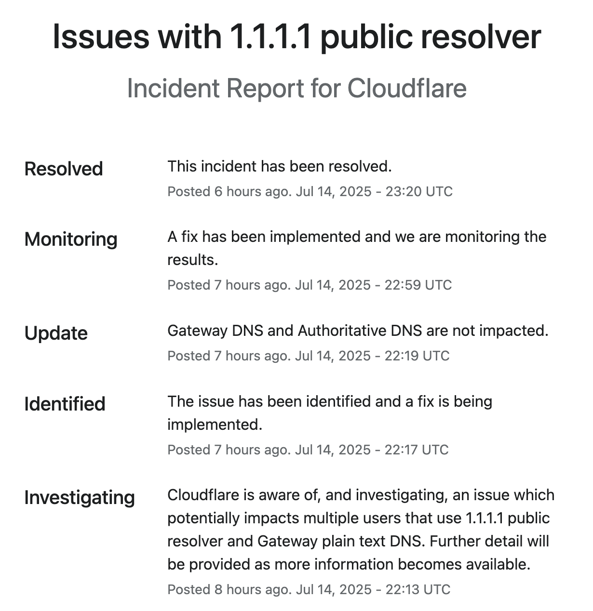
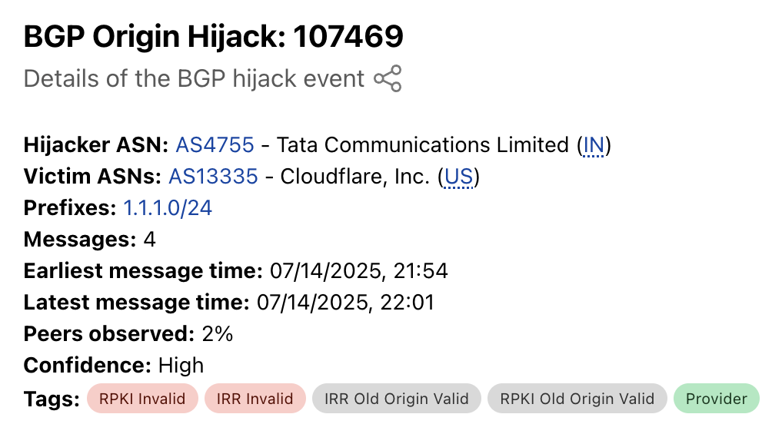
Recursive Resolver Failures
What happens if a resolver breaks?
Anyone relying on 1.1.1.1 to resolve DNS queries cannot access webpages.
Resolvers can be a single point of failure!
Yesterday, 1.1.1.1 stopped responding.
Maybe a BPG issue?
Notes:
https://www.cloudflarestatus.com/incidents/28r0vbbxsh8f
https://radar.cloudflare.com/routing/anomalies/hijack-107469

Slide 31
DNS Implementation
DNS
What is DNS For?
Design
Implementation
Scaling
Other Uses
Lecture 14, CS 168, Spring 2026

Slide 32
APIs for Developers
What does DNS look like from a developer perspective?
Relatively simple, common APIs that are available in almost all languages.
Example API in C:
result = gethostbyname("foo.com")
  Limited to IPv4.
  Deprecated, but still used.
error = getaddrinfo("example.com", NULL, NULL, &result)
  Replaces the deprecated method.
  Supports more than IPv4.
Functions usually just make requests to the OS's configured resolving DNS server.
All the complexities of DNS hidden from the end developer.

Slide 33
DNS Uses UDP
Recall UDP vs. TCP:
UDP: Unreliable, but faster.
TCP: Reliable, but slower.
DNS should be lightweight and fast, so it uses UDP.
No 3-way handshake needed.
No need for servers to maintain connection state.
Most queries/responses fit in a single UDP packet (no bytestream needed).

Slide 34
DNS Uses UDP
What if a packet is dropped?
Set a timer, and retry on timeout.
Varies on different OSes, but can be fairly slow.
  This is why resolvers need to be highly-available.
What if a message doesn't fit in a UDP packet?
Generally never happens on typical requests and responses.
Larger messages can be sent over TCP.
Recent advances in DNS use a secure transport protocol, with encryption.
TCP and UDP are vulnerable to attackers.

Slide 35
DNS Packet Format: UDP Header
Source port (16 bits): Chosen by the client.
Destination port (16 bits): Usually 53.
Servers typically listen for queries on a well-known UDP port (53).
Checksum on UDP payload.
Length of UDP payload.
Source Port | Destination Port
Checksum | Length
ID number | Flags
Question count | Answer count
Authority count | Additional count
Question Records
Answer Records
Authority Records
Additional Records
UDP Header
UDP Payload

Slide 36
DNS Packet Format: DNS Header
ID number (16 bits): Used to associate queries with responses.
Client picks an ID number in the query.
Name server uses the same ID number in the response.
Should be randomly chosen for security purposes (not discussed further).
Source Port | Destination Port
Checksum | Length
ID number | Flags
Question count | Answer count
Authority count | Additional count
Question Records
Answer Records
Authority Records
Additional Records
UDP Header
DNS Header
DNS Payload

Slide 37
DNS Packet Format: DNS Header
Flags:
QR bit: 0 in queries, 1 in responses.
RD bit: 1 if we want the recursive resolver to do the lookup for us, and 0 otherwise.
In theory, there are different query types.
  IQUERY: Obsolete.
  STATUS: Not really defined.
  QUERY: Used for basically everything.
Counts: The number of records of each type in the DNS payload.
Source Port | Destination Port
Checksum | Length
ID number | Flags
Question count | Answer count
Authority count | Additional count
Question Records
Answer Records
Authority Records
Additional Records
UDP Header
DNS Header
DNS Payload

Slide 38
DNS Packet Format: DNS Payload
The DNS payload contains a variable number of resource records (RRs).
Each RR is a name-value pair.
RRs are sorted into four sections:
Question section.
Answer section.
Authority section.
Additional section.
Source Port | Destination Port
Checksum | Length
ID number | Flags
Question count | Answer count
Authority count | Additional count
Question Records
Answer Records
Authority Records
Additional Records
UDP Header
DNS Header
DNS Payload

Slide 39
DNS Record Format
Each record is a name-value pair with a type.
A (answer) type records: Maps a domain name to an IPv4 address.
AAAA type records: Maps a domain name to an IPv6 address.
NS (name server) type records: Designates another DNS server to handle a domain.
Other types exist, but these are the ones you need to know for now.
Each record also contains some metadata.
Time to live (TTL): How long the record can be cached.
Class: We'll ignore this. Basically always set to IN (Internet).

Slide 40
DNS Record Sections
Question section: What is being asked.
Included in both requests and responses.
Usually an A type record with the domain being looked up.
Answer section: A direct response to the question.
Empty in requests.
Used if the name server responds with the answer.
Usually an A type record with the IP address of the domain being looked up.

Slide 41
DNS Record Sections
Authority section: A delegation of authority for the question.
Empty in requests.
Used to direct the resolver to the next name server.
Usually an NS type record with the zone and domain of the child name server.
Additional section: Additional information to help with the response, sometimes called glue records.
Empty in requests.
Provides helpful, non-authoritative records for domains.
Usually an A type record with the domain and IP address of the child name server (since the NS record provides the child name server as a domain).

Slide 42
DNS Lookup Walkthrough
$ dig +norecurse eecs.berkeley.edu @198.41.0.4
You can try this at home! Use the dig utility in your terminal, and remember to set the +norecurse flag so you can traverse the name server hierarchy yourself.

Slide 43
DNS Lookup Walkthrough
$ dig +norecurse eecs.berkeley.edu @198.41.0.4
We are performing a DNS lookup for the IP address of eecs.berkeley.edu.

Slide 44
DNS Lookup Walkthrough
$ dig +norecurse eecs.berkeley.edu @198.41.0.4
DNS queries always start with a request to the root name server. The IP address of the root name server is usually hard-coded into recursive resolvers.
Operators can also configure a root hints file with the root addresses, like this: https://www.internic.net/domain/named.root

Slide 45
DNS Lookup Walkthrough
$ dig +norecurse eecs.berkeley.edu @198.41.0.4
;; Got answer:
;; ->>HEADER<<- opcode: QUERY, status: NOERROR, id: 26114
;; flags: qr; QUERY: 1, ANSWER: 0, AUTHORITY: 13, ADDITIONAL: 27
;; QUESTION SECTION:
;eecs.berkeley.edu. IN A
;; AUTHORITY SECTION:
edu. 172800 IN NS a.edu-servers.net.
edu. 172800 IN NS b.edu-servers.net.
edu. 172800 IN NS c.edu-servers.net.
...
;; ADDITIONAL SECTION:
a.edu-servers.net. 172800 IN A 192.5.6.30
b.edu-servers.net. 172800 IN A 192.33.14.30
c.edu-servers.net. 172800 IN A 192.26.92.30
...
Here's the DNS response from the root name server.

Slide 46
DNS Lookup Walkthrough
$ dig +norecurse eecs.berkeley.edu @198.41.0.4
;; Got answer:
;; ->>HEADER<<- opcode: QUERY, status: NOERROR, id: 26114
;; flags: qr; QUERY: 1, ANSWER: 0, AUTHORITY: 13, ADDITIONAL: 27
;; QUESTION SECTION:
;eecs.berkeley.edu. IN A
;; AUTHORITY SECTION:
edu. 172800 IN NS a.edu-servers.net.
edu. 172800 IN NS b.edu-servers.net.
edu. 172800 IN NS c.edu-servers.net.
...
;; ADDITIONAL SECTION:
a.edu-servers.net. 172800 IN A 192.5.6.30
b.edu-servers.net. 172800 IN A 192.33.14.30
c.edu-servers.net. 172800 IN A 192.26.92.30
...
Here's the DNS header.

Slide 47
DNS Lookup Walkthrough
$ dig +norecurse eecs.berkeley.edu @198.41.0.4
;; Got answer:
;; ->>HEADER<<- opcode: QUERY, status: NOERROR, id: 26114
;; flags: qr; QUERY: 1, ANSWER: 0, AUTHORITY: 13, ADDITIONAL: 27
;; QUESTION SECTION:
;eecs.berkeley.edu. IN A
;; AUTHORITY SECTION:
edu. 172800 IN NS a.edu-servers.net.
edu. 172800 IN NS b.edu-servers.net.
edu. 172800 IN NS c.edu-servers.net.
...
;; ADDITIONAL SECTION:
a.edu-servers.net. 172800 IN A 192.5.6.30
b.edu-servers.net. 172800 IN A 192.33.14.30
c.edu-servers.net. 172800 IN A 192.26.92.30
...
Here's the 16-bit ID number in the DNS header.

Slide 48
DNS Lookup Walkthrough
$ dig +norecurse eecs.berkeley.edu @198.41.0.4
;; Got answer:
;; ->>HEADER<<- opcode: QUERY, status: NOERROR, id: 26114
;; flags: qr; QUERY: 1, ANSWER: 0, AUTHORITY: 13, ADDITIONAL: 27
;; QUESTION SECTION:
;eecs.berkeley.edu. IN A
;; AUTHORITY SECTION:
edu. 172800 IN NS a.edu-servers.net.
edu. 172800 IN NS b.edu-servers.net.
edu. 172800 IN NS c.edu-servers.net.
...
;; ADDITIONAL SECTION:
a.edu-servers.net. 172800 IN A 192.5.6.30
b.edu-servers.net. 172800 IN A 192.33.14.30
c.edu-servers.net. 172800 IN A 192.26.92.30
...
Here are the record counts in the DNS header.
Here are the flags in the DNS header.

Slide 49
DNS Lookup Walkthrough
$ dig +norecurse eecs.berkeley.edu @198.41.0.4
;; Got answer:
;; ->>HEADER<<- opcode: QUERY, status: NOERROR, id: 26114
;; flags: qr; QUERY: 1, ANSWER: 0, AUTHORITY: 13, ADDITIONAL: 27
;; QUESTION SECTION:
;eecs.berkeley.edu. IN A
;; AUTHORITY SECTION:
edu. 172800 IN NS a.edu-servers.net.
edu. 172800 IN NS b.edu-servers.net.
edu. 172800 IN NS c.edu-servers.net.
...
;; ADDITIONAL SECTION:
a.edu-servers.net. 172800 IN A 192.5.6.30
b.edu-servers.net. 172800 IN A 192.33.14.30
c.edu-servers.net. 172800 IN A 192.26.92.30
...
Here's the DNS payload. It's a collection of resource records (one per line), sorted into four sections.

Slide 50
DNS Lookup Walkthrough
$ dig +norecurse eecs.berkeley.edu @198.41.0.4
;; Got answer:
;; ->>HEADER<<- opcode: QUERY, status: NOERROR, id: 26114
;; flags: qr; QUERY: 1, ANSWER: 0, AUTHORITY: 13, ADDITIONAL: 27
;; QUESTION SECTION:
;eecs.berkeley.edu. IN A
;; AUTHORITY SECTION:
edu. 172800 IN NS a.edu-servers.net.
edu. 172800 IN NS b.edu-servers.net.
edu. 172800 IN NS c.edu-servers.net.
...
;; ADDITIONAL SECTION:
a.edu-servers.net. 172800 IN A 192.5.6.30
b.edu-servers.net. 172800 IN A 192.33.14.30
c.edu-servers.net. 172800 IN A 192.26.92.30
...
Here's the question section. The name is eecs.berkeley.edu, the type is A, and the value is blank. It shows that we are looking for the IP address of eecs.berkeley.edu.

Slide 51
DNS Lookup Walkthrough
$ dig +norecurse eecs.berkeley.edu @198.41.0.4
;; Got answer:
;; ->>HEADER<<- opcode: QUERY, status: NOERROR, id: 26114
;; flags: qr; QUERY: 1, ANSWER: 0, AUTHORITY: 13, ADDITIONAL: 27
;; QUESTION SECTION:
;eecs.berkeley.edu. IN A
;; AUTHORITY SECTION:
edu. 172800 IN NS a.edu-servers.net.
edu. 172800 IN NS b.edu-servers.net.
edu. 172800 IN NS c.edu-servers.net.
...
;; ADDITIONAL SECTION:
a.edu-servers.net. 172800 IN A 192.5.6.30
b.edu-servers.net. 172800 IN A 192.33.14.30
c.edu-servers.net. 172800 IN A 192.26.92.30
...
The answer section is blank, because the root name server did not return the answer we're looking for.
We can confirm this by checking the header, which says there are 0 records in the answer section.

Slide 52
DNS Lookup Walkthrough
$ dig +norecurse eecs.berkeley.edu @198.41.0.4
;; Got answer:
;; ->>HEADER<<- opcode: QUERY, status: NOERROR, id: 26114
;; flags: qr; QUERY: 1, ANSWER: 0, AUTHORITY: 13, ADDITIONAL: 27
;; QUESTION SECTION:
;eecs.berkeley.edu. IN A
;; AUTHORITY SECTION:
edu. 172800 IN NS a.edu-servers.net.
edu. 172800 IN NS b.edu-servers.net.
edu. 172800 IN NS c.edu-servers.net.
...
;; ADDITIONAL SECTION:
a.edu-servers.net. 172800 IN A 192.5.6.30
b.edu-servers.net. 172800 IN A 192.33.14.30
c.edu-servers.net. 172800 IN A 192.26.92.30
...
The authority and additional sections tell the resolver where to look next.
Note that there are multiple .edu name servers for redundancy.

Slide 53
DNS Lookup Walkthrough
$ dig +norecurse eecs.berkeley.edu @198.41.0.4
;; Got answer:
;; ->>HEADER<<- opcode: QUERY, status: NOERROR, id: 26114
;; flags: qr; QUERY: 1, ANSWER: 0, AUTHORITY: 13, ADDITIONAL: 27
;; QUESTION SECTION:
;eecs.berkeley.edu. IN A
;; AUTHORITY SECTION:
edu. 172800 IN NS a.edu-servers.net.
edu. 172800 IN NS b.edu-servers.net.
edu. 172800 IN NS c.edu-servers.net.
...
;; ADDITIONAL SECTION:
a.edu-servers.net. 172800 IN A 192.5.6.30
b.edu-servers.net. 172800 IN A 192.33.14.30
c.edu-servers.net. 172800 IN A 192.26.92.30
...
For redundancy, there are usually several name servers for each zone. Any of them will usually work. Let's pick the first one.
This NS record says that a.edu-servers.net is a .edu name server.

Slide 54
DNS Lookup Walkthrough
$ dig +norecurse eecs.berkeley.edu @198.41.0.4
;; Got answer:
;; ->>HEADER<<- opcode: QUERY, status: NOERROR, id: 26114
;; flags: qr; QUERY: 1, ANSWER: 0, AUTHORITY: 13, ADDITIONAL: 27
;; QUESTION SECTION:
;eecs.berkeley.edu. IN A
;; AUTHORITY SECTION:
edu. 172800 IN NS a.edu-servers.net.
edu. 172800 IN NS b.edu-servers.net.
edu. 172800 IN NS c.edu-servers.net.
...
;; ADDITIONAL SECTION:
a.edu-servers.net. 172800 IN A 192.5.6.30
b.edu-servers.net. 172800 IN A 192.33.14.30
c.edu-servers.net. 172800 IN A 192.26.92.30
...
This A record helpfully tells us the IP address of the next name server we mean to contact.

Slide 55
DNS Lookup Walkthrough
$ dig +norecurse eecs.berkeley.edu @192.5.6.30
Next, we query the .edu name server. We know the IP address of the .edu name server because the root name server gave the information to us.

Slide 56
DNS Lookup Walkthrough
$ dig +norecurse eecs.berkeley.edu @192.5.6.30
;; Got answer:
;; ->>HEADER<<- opcode: QUERY, status: NOERROR, id: 36257
;; flags: qr; QUERY: 1, ANSWER: 0, AUTHORITY: 3, ADDITIONAL: 5
;; QUESTION SECTION:
;eecs.berkeley.edu. IN A
;; AUTHORITY SECTION:
berkeley.edu. 172800 IN NS adns1.berkeley.edu.
berkeley.edu. 172800 IN NS adns2.berkeley.edu.
berkeley.edu. 172800 IN NS adns3.berkeley.edu.
;; ADDITIONAL SECTION:
adns1.berkeley.edu. 172800 IN A 128.32.136.3
adns2.berkeley.edu. 172800 IN A 128.32.136.14
adns3.berkeley.edu. 172800 IN A 192.107.102.142
...
The answer section is blank again. The authority and additional section tell us to query a berkeley.edu name server, and provide us with the IP address of the next name server.

Slide 57
DNS Lookup Walkthrough
$ dig +norecurse eecs.berkeley.edu @128.32.136.3
Next, we query the berkeley.edu name server for the IP address of eecs.berkeley.edu. We know the IP address of the berkeley.edu name server because the root name server gave the information to us.

Slide 58
DNS Lookup Walkthrough
$ dig +norecurse eecs.berkeley.edu @128.32.136.3
;; Got answer:
;; ->>HEADER<<- opcode: QUERY, status: NOERROR, id: 52788
;; flags: qr aa; QUERY: 1, ANSWER: 1, AUTHORITY: 0, ADDITIONAL: 1
;; QUESTION SECTION:
;eecs.berkeley.edu. IN A
;; ANSWER SECTION:
eecs.berkeley.edu. 86400 IN A 23.185.0.1
The answer section has one A type record. It tells us that the IP address of eecs.berkeley.edu is 23.185.0.1.

Slide 59
DNS Lookup Walkthrough
$ dig +norecurse eecs.berkeley.edu @128.32.136.3
;; Got answer:
;; ->>HEADER<<- opcode: QUERY, status: NOERROR, id: 52788
;; flags: qr aa; QUERY: 1, ANSWER: 1, AUTHORITY: 0, ADDITIONAL: 1
;; QUESTION SECTION:
;eecs.berkeley.edu. IN A
;; ANSWER SECTION:
eecs.berkeley.edu. 86400 IN A 23.185.0.1
Here's the time-to-live (TTL) field in the record. It tells us that we can cache this answer for 86,400 seconds (24 hours).
We finished our original query!
Let's try a few other queries.

Slide 60
DNS Lookup Walkthrough
Let's try asking for a different domain.
$ dig +norecurse repo.eecs.berkeley.edu @128.32.136.3
;; Got answer:
;; ->>HEADER<<- opcode: QUERY, status: NOERROR, id: 25192
;; flags: qr aa; QUERY: 1, ANSWER: 1, AUTHORITY: 0, ADDITIONAL: 1
;; QUESTION SECTION:
;repo.eecs.berkeley.edu. IN A
;; ANSWER SECTION:
repo.eecs.berkeley.edu. 21600 IN CNAME repo-2.eecs.berkeley.edu
repo-2.eecs.berkeley.edu 21600 IN A 128.32.138.46
New record type: CNAME tells us that repo.eecs.berkeley.edu is actually an alias (alternate name) for repo-2.eecs.berkeley.edu.
Then, the A record tells us the IP address for the true name, repo-2.eecs.berkeley.edu.

Slide 61
DNS Lookup Walkthrough
Let's try specifically requesting the IPv6 address.
$ dig +norecurse repo.eecs.berkeley.edu AAAA @128.32.136.3
;; Got answer:
;; ->>HEADER<<- opcode: QUERY, status: NOERROR, id: 25192
;; flags: qr aa; QUERY: 1, ANSWER: 0, AUTHORITY: 1, ADDITIONAL: 1
;; QUESTION SECTION:
;repo.eecs.berkeley.edu. IN AAAA
;; AUTHORITY SECTION:
eecs.berkeley.edu. 1971 IN SOA ns.eecs.berkeley.edu, dns.eecs.berkeley.edu, 100012225 10887 3600 604800 86400
The answer section is blank, because this domain does not have an IPv6 address.
We got some information about who's operating the zone.

Slide 62
Scaling DNS
DNS
What is DNS For?
Design
Implementation
Scaling
Other Uses
Lecture 14, CS 168, Spring 2026

Slide 63
DNS Hierarchy
The DNS tree represents 3 forms of hierarchy.
Names are hierarchical. This is why our domain names are words separated by dots.
. (root)
edu
berkeley
ischool
math
eecs
pink.ischool.berkeley.edu.
pink
repo
rise
rise.eecs.berkeley.edu.

Slide 64
DNS Hierarchy
Authority is hierarchical. Each organization manages a zone, and can delegate parts of the zone to other organizations.
. (root)
edu
UC Berkeley owns the berkeley.edu zone.
berkeley
ischool
math
eecs
UC Berkeley gives the eecs.berkeley.edu zone to the EECS department.
pink
repo
rise

Slide 65
DNS Hierarchy
Infrastructure is hierarchical. Each name server only needs to know about a subset of domains.
. (root)
I have to answer all berkeley.edu queries.
For eecs.berkeley.edu queries, I can redirect users to that name server.
edu
berkeley
ischool
math
eecs
pink
repo
rise

Slide 66
DNS Hierarchy
Each node in the tree represents a zone of domains.
An organization managing a zone can delegate part of its zone to somebody else.
Each zone has an authoritative name server that knows about the domains in that zone.
The berkeley.edu zone
Owned by: UC Berkeley
Name server: adns1.berkeley.edu
Manages:
www.berkeley.edu
calcentral.berkeley.edu
systemstatus.berkeley.edu
...
The ischool.berkeley.edu zone
Owned by: School of Information
Name server: is-dns.berkeley.edu
Manages:
pink.ischool.berkeley.edu
blue.ischool.berkeley.edu
...
The eecs.berkeley.edu zone
Owned by: EECS Department
Name server: cs-dns.berkeley.edu
Manages:
repo.eecs.berkeley.edu
rise.eecs.berkeley.edu
...

Slide 67
DNS Hierarchy
A zone corresponds to an administrative authority response for some part of the hierarchy.
A zone is authoritative for how names within that part of the hierarchy are controlled.
You can choose to delegate authority for part of the zone to somebody else.
Zones help DNS scale.
Different administrative authorities are responsible for different parts of the hierarchy.
Example: Educause (.edu zone operators) don't have to know about what's happening in the berkeley.edu zone (authority delegated to UC Berkeley).

Slide 68
Administrative Authorities
The DNS root is controlled by ICANN.
Internet Corporation for Assigned Names and Numbers.
. (root)
...
com
edu
org
uk
fr
jp
...
co
ac
google
amazon

Slide 69
Administrative Authorities
Top-level domains (TLDs) are the zones directly below root.
Historically, relatively few, based on purpose (organization, education, commercial, etc.), and country (UK, France, Japan, etc.).
More recently, many more weird ones (.travel, .pizza, etc.). Over 1500 TLDs today!
. (root)
TLDs
...
com
edu
org
uk
fr
jp
...
co
ac
google
amazon

Slide 70
Administrative Authorities
Second-level domains, third-level domains, etc. are below TLDs.
Each TLD can decide its own structure.
Example: The .uk zone delegated .co.uk (commercial) and .ac.uk (academic).
. (root)
TLDs
...
com
edu
org
uk
fr
jp
...
Second-level domains
co
ac
Third-level domains
google
amazon

Slide 71
Administrative Authorities
Users can lease specific domains from domain registries (e.g. Verisign).
If you want to host your website on example.com, you have to reserve the domain for a recurring (e.g. monthly) fee.
Then, the authoritative .com name servers add a record mapping example.com to your IP address.
Organizations (e.g. Google, Amazon) can operate their own zones, with their own name servers.
The organization has to tell its parent about its name server(s).
Then, the parent will redirect queries to the organization.

Slide 72
Zone Availability
Recall: Each zone has several name servers for redundancy.
Zones "must" have two authoritative name servers.
This ensures availability of that zone.
The name servers work in a primary/secondary model.
The primary name server manages and updates the actual records.
The secondary name server uses a read-only copy of the primary server's records.
The primary server periodically transfers its records to the secondary servers.
  Transfer can be large! This is where DNS might use TCP instead of UDP.
"Must" = it's standard practice, and many registrars require it.

Slide 73
Root Zone Availability with Anycast
It would be really bad if the root servers were unavailable.
Someone with an empty cache would be unable to make any lookups.
Root servers use a trick called anycast to ensure high availability.
There are only 13 root-server domains (a.root-servers.net to m.root-servers.net).
But, there are actually thousands of root servers.
Anycast: Use the same IP address for many servers on the Internet.
Thousands of servers all claim to be k.root-servers.net with address 193.0.14.129 in routing protocols.
You might hear advertisements from many different servers. You can pick any route (e.g. the shortest one), and you'll reach one of the root servers.
Anycast can also be used for other highly-available services (e.g. the 8.8.8.8 resolver).

Slide 74
Root Zone Availability with Anycast
All of these servers are advertising themselves as k.root-servers.net, with IP 193.0.14.129.
Lots of cooperation between network operators to keep root servers highly available.
Which instance am I actually using?
$ dig +short +norec @k.root-servers.net hostname.bind chaos txt
"ns1.us-mia.k.ripe.net"
"us-mia" is probably Miami, Florida.
Notes:
https://www.ripe.net/analyse/dns/k-root/

Slide 75
Other Uses of DNS
DNS
What is DNS For?
Design
Implementation
Scaling
Other Uses
Lecture 14, CS 168, Spring 2026

Slide 76
Other Uses of DNS: Email
DNS can store and serve more than just domain-to-IP mappings. Example: Email.
To send email to evanbot@berkeley.edu, we need to know where to send packets.
MX type records map a domain to a mail server.
  Historically: The mail server ran on a user's machine.
  Today: Email services (e.g. Gmail) run mail servers, which receive your mail and let you access your mail.
MX records contain a priority in the value.
  If you receive multiple MX records for a domain, try lowest number first.
Priorities.
Gmail mail servers.
$ dig eecs.berkeley.edu MX
;; ANSWER SECTION:
eecs.berkeley.edu 10549 IN MX 1 aspmx.l.google.com
eecs.berkeley.edu 10549 IN MX 5 alt1.aspmx.l.google.com
eecs.berkeley.edu 10549 IN MX 5 alt2.aspmx.l.google.com
eecs.berkeley.edu 10549 IN MX 10 alt4.aspmx.l.google.com
eecs.berkeley.edu 10549 IN MX 10 alt3.aspmx.l.google.com
Notes:
In the old days, email servers used to run on computers
Need to convert mail addresses into ip addresses

Slide 77
DNS for Load-Balancing
Multiple servers with different IP addresses can all host the same application.
Useful for popular services (e.g. YouTube, Twitter).
The name server can return multiple IP addresses for a single domain.
  No precedence between these different A records.
  Client can pick any of them. We often pick the first one.
  Server shuffles the order in the response.
Provides coarse-grained load-balancing across different servers.
Provides simple resiliency. If one IP is down, pick another.
;; ANSWER SECTION:
microsoft.com. 1999 IN A 20.112.250.133
microsoft.com. 1999 IN A 20.231.239.246
microsoft.com. 1999 IN A 20.76.201.171
microsoft.com. 1999 IN A 20.70.246.20
microsoft.com. 1999 IN A 20.236.44.162

Slide 78
DNS for Load-Balancing
The name server can give different responses based on where the query came from.
Server needs extra logic: "If the query is from X, reply with Y."
How do we determine which response to give?
Address of the recursive resolver.
  Most clients don't directly query name servers.
Address of the client.
  Requires extension to DNS to carry client address.
Geographical location of the client.
  Requires database to map IP addresses to physical locations, e.g. MaxMind.
From California:
From Oregon:
$ dig google.com +short
142.251.46.238
$ dig google.com +short
74.125.135.113

Slide 79
DNS for Load-Balancing
Challenges with geographical load-balancing:
Ideally, we want to direct the client to the "nearest" server.
We don't know the how "far" the user is from the server.
  We don't know the geographic distance.
  We don't know the network distance (e.g. number of hops).
We don't know the performance between the user and the server.
  What's the bandwidth and latency of the links between user and server?
Some guessing is involved.
Some proprietary logic is required at the name server.

Slide 80
DNS for Load-Balancing
Load-balancing experiment:
From San Francisco, ask for the IPv6 address of www.youtube.com.
Look up the name corresponding to that specific IP address.
sfo03s25-in-x0e.1e100.net. "SFO" = San Francisco...pretty close!
Another load-balancing experiment:
From Oregon, ask for the IPv6 address of www.youtube.com.
San Francisco → IP address from San Francisco request = 20 ms RTT.
San Francisco → IP address from Oregon request = 35 ms RTT.
Mapping logic gave us a way to map a client to a better-performing server.
Doing a "reverse" DNS lookup from IP address to hostname:
$ host 2607:f8b0:4005:80d::200e
e.0.0.2.0.0.0.0.0.0.0.0.0.0.0.0.d.0.8.0.5.0.0.4.0.b.8.f.7.0.6.2.ip6.arpa domain
name pointer sfo03s25-in-x0e.1e100.net.

Slide 81
Summary: DNS
DNS was created to allow for name to IP address resolution.
  Helps humans easily access things on the Internet.
DNS is a hierarchical system.
  Zones and name servers have a hierarchy.
  Allows for delegation to authoritative entities.
DNS is implemented over UDP, and organizes data in records of various types.
DNS extends beyond address resolution into service resolution (e.g. email).
DNS can be used for load-balancing.

